Slide 1


Semester 1 2022/2023
Sistem Pengawasan Nuklir (RN6086)
FMIPA ITB
Sistem Pengawasan Nuklir (RN6086)
Konsep 3S dan konsep dasar keamanan (security)
Sidik Permana dan Sparisoma Viridi Nuclear Physics and Biophysics Research Division
Physics Department, Nuclear Science and Engineering Department, Faculty of Matematis and Natural Sciences, Institut Teknologi Bandung

Slide 2

Pokok Bahasan Mata Kuliah
Sistem Pengawasan Nuklir
1. tekait tema pengawasan, juga tema keselamatan atau safety dan juga keamanan atau security fasilitas nuklir
2. Sinergitas konsep 3S safety, secuarity dan safeguard proses dan implementasinya,
5. material nuklir terkait daur ulang bahan bakar, kuantitas materil nuklir terkait data
3. konsep dasar depence in depth dari safety dan safeguard,
6. pelaporan khusunya material nuklir terkait uranium dan plutonium
4. analisa desain basis dari konsep safety dan safeguard by design
7. konsep non proliferasi nuklir, pengetahuan mengenai protected plutonium proliferation
8. Konsep material attractiveness,
Sistem Pengawasan Nuklir (RN6086) Semester 1, TA 2022/2023, Program Studi Magister Ilmu dan Rekayasa Nuklir, FMIPA ITB

Slide 3
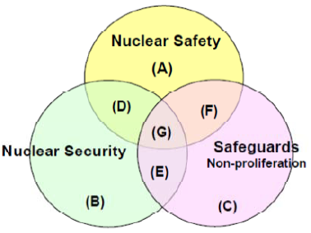
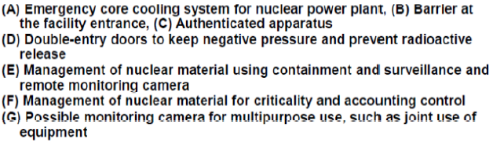


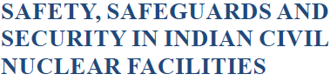
Sinergisasi Konsep 3 S
Sistem Pengawasan Nuklir (RN6086) Semester 1, TA 2022/2023, Program Studi Magister Ilmu dan Rekayasa Nuklir, FMIPA ITB

Slide 4
Konsep 3 S Nuklir
• Safety, Security, Safeguards as policy areas: forms of governance developed to manage risks connected to the use of nuclear technology.
• Action at different levels: – Facility: Management, internal rules, practices – National: Policies, regulatory framework
– International: treaties, cooperation agreeements, trade control regimes, IAEA
Sumber : Alberto Muti , Nuclear Safety, Security and Safeguards, VERTIC
Sistem Pengawasan Nuklir (RN6086) Semester 1, TA 2022/2023, Program Studi Magister Ilmu dan Rekayasa Nuklir, FMIPA ITB

Slide 5
Konsep Keselamatan (Safety)
Nuclear Safety
“The achievement of proper operating conditions, prevention of accidents or mitigation of accident consequences, resulting in protection of workers, the public and the environment from undue radiation hazards.”
IAEA Nuclear Safety Glossary
Nuclear Safety – International
Key International Agreements on Nuclear Safety:
Convention on Nuclear Safety(1994)
Joint Convention on the Safety of Spent Fuel Management and on the Safety of Radioactive Waste Management (1997)
Convention on Early Notification of a Nuclear Accident (1986)
Convention on Assistance in the Case of a Nuclear Accident or Radiological Emergency (1986)
IAEA supports the implementation of these treaties and encourages ratification
– IAEA acts as coordination body for the implementation of these treaties
IAEA supports improvements in Nuclear Safety in Member States
IAEA Action Plan on Nuclear Safety (2011)
IAEA Assistance
Sumber : Alberto Muti , Nuclear Safety, Security and Safeguards, VERTIC
Sistem Pengawasan Nuklir (RN6086) Semester 1, TA 2022/2023, Program Studi Magister Ilmu dan Rekayasa Nuklir, FMIPA ITB

Slide 6
Konsep Keamanan (Security)
Nuclear Security
“The prevention and detection of, and response to, theft, sabotage, unauthorized access, illegal transfer or other malicious acts involving nuclear material, other radioactive substances or their associated facilities.”
IAEA Nuclear Safety Glossary
Nuclear Security
The youngest of the “Three S”
Energised by changes in the international environment: – Disgregation of the former Soviet Union
– 9/11 Attacks and “War on Terror”
Since then, it has risen to prominence in international agenda – and profoundly changed as a concept
Nuclear Security is a responsibility of the state
• “Original” nuclear security was physical protection: guards, gates and guns
– Principles such as “Defence in Depth” and “Deter, Detect, Delay, Respond, Recover”
• Over time, the concept expanded to include the human elements of security:
– Insider Threat – “Security Culture” among facility staff
Sumber : Alberto Muti , Nuclear Safety, Security and Safeguards, VERTIC
Sistem Pengawasan Nuklir (RN6086) Semester 1, TA 2022/2023, Program Studi Magister Ilmu dan Rekayasa Nuklir, FMIPA ITB

Slide 7
Konsep Keamanan (Security)
Nuclear Security – International
Key International initiatives on Nuclear Security:
Cooperative Threat Reduction Programmes (1990s onwards)
Global Partnership (G7-backed, 31 members, 2002)
Nuclear Security Summits (2010-2016)
US Partnership for Nuclear Security
EU CBRN Centres of Excellence
Convention on the Physical Protection of Nuclear Material (1980) + 2005 Amendment
Code of Conduct on the Safety and Security of Radioactive Sources
International Convention for the Suppression of Acts of Nuclear Terrorism (2007)
UN Security Council Resolutions:
– 1373 (2001) – 1540 (2004)
Not all these instruments relate back to the IAEA – the international framework is more fragmented
The IAEA has stepped up to provide a coordination and support role on nuclear security after 2001
Key documents: Nuclear Security Plans, starting in 2003. Current plan is 2018-2021
Sumber : Alberto Muti , Nuclear Safety, Security and Safeguards, VERTIC
Sistem Pengawasan Nuklir (RN6086) Semester 1, TA 2022/2023, Program Studi Magister Ilmu dan Rekayasa Nuklir, FMIPA ITB

Slide 8
Traditional safeguards
Konsep Seifgard (Safeguard)
Traditional safeguards use “material accountancy” and “containment and surveillance” to provide timely detection of diversion of significant quantities of nuclear material, and to deter such diversion by the risk of detection
Significant quantities:
Pu or U233: 8 kg
HEU: 25 kg contained U-235
Bombs can be made with less -- a key issue
Timeliness goal:
1 month for unirradiated Pu or HEU (incl. MOX)
Longer than estimated conversion time – another key issue
Sumber : How IAEA Safeguards Work, Matthew Bunn IGA-232, Controlling the World’s Most Dangerous Weapons, 20 September 2013, belfercenter.org/mta
Sistem Pengawasan Nuklir (RN6086) Semester 1, TA 2022/2023, Program Studi Magister Ilmu dan Rekayasa Nuklir, FMIPA ITB

Slide 9
Material accountancy
Konsep Seifgard (Safeguard)
MUF (Material Unaccounted For) =
Beginning inventory + Additions to inventory - Ending inventory - Removals from inventory
Because of measurement uncertainties, all bulk facilities have some MUF – but does it mean a real loss?
σMUF -- standard deviation of MUF -- is measurement precision
If MUF > than some threshold level -- usually 3 σMUF -- IAEA rejects the hypothesis that real MUF is zero, investigates possibility that diversion has occurred
For item facility (e.g., LWR), MUF=0 unless something is missing
These days MUF sometimes called “inventory difference” or ID
Sumber : How IAEA Safeguards Work, Matthew Bunn IGA-232, Controlling the World’s Most Dangerous Weapons, 20 September 2013, belfercenter.org/mta
Sistem Pengawasan Nuklir (RN6086) Semester 1, TA 2022/2023, Program Studi Magister Ilmu dan Rekayasa Nuklir, FMIPA ITB

Slide 10
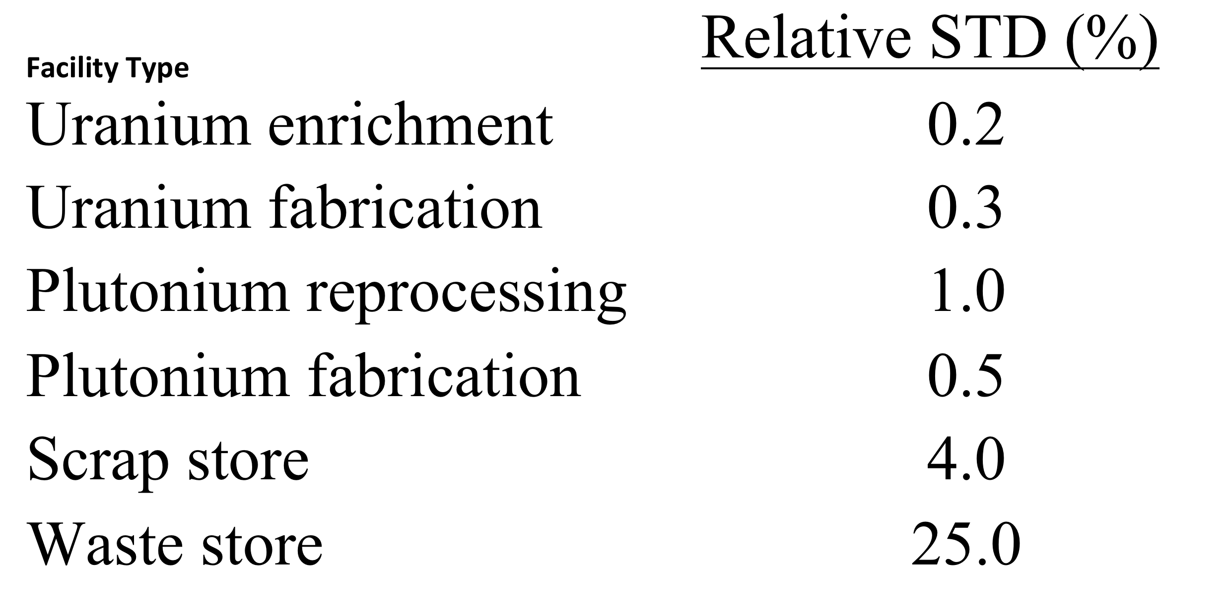
International accountancy standards
Konsep Seifgard (Safeguard)
Source: IAEA Inspector Training Course
Sumber : How IAEA Safeguards Work, Matthew Bunn IGA-232, Controlling the World’s Most Dangerous Weapons, 20 September 2013, belfercenter.org/mta
Sistem Pengawasan Nuklir (RN6086) Semester 1, TA 2022/2023, Program Studi Magister Ilmu dan Rekayasa Nuklir, FMIPA ITB

Slide 11
Containment and surveillance
Konsep Seifgard (Safeguard)
Containment and surveillance complements material accountancy by (a) detecting unusual activities, (b) confirming there has been no removal of material from measured, sealed containers
Typical measures include:
Surveillance cameras
Tamper-resistant seals (which will be broken if sealed item is opened)
Tamper-resistant tags (uniquely identify particular measured items)
What happens when cameras go out, seals break? Often, re-inspection required
Clearly, containment and surveillance contribute to safeguards confidence – but no one has come up with a way to measure how much better accountancy is with containment and surveillance added
Sumber : How IAEA Safeguards Work, Matthew Bunn IGA-232, Controlling the World’s Most Dangerous Weapons, 20 September 2013, belfercenter.org/mta
Sistem Pengawasan Nuklir (RN6086) Semester 1, TA 2022/2023, Program Studi Magister Ilmu dan Rekayasa Nuklir, FMIPA ITB

Slide 12
Safeguarding a reprocessing plant
Konsep Seifgard (Safeguard)
Large commercial plant: 800 MTHM/yr, ~8 tPu/yr
1 close-out for measured inventory/yr
1% uncertainty ≈ 80 kg Pu
If only challenge if MUF>3 σMUF ➔ 240 kg Pu
Also, can’t meet timeliness goal with 1 inventory/yr
Partial solutions:
Comprehensive transparency and containment and surveillance throughout plant – monitor all flows, detect all unusual activity
Near-real-time accountancy – much more frequent partial measurements of material in process, with statistical models designed to detect both abrupt and protracted diversions
Sumber : How IAEA Safeguards Work, Matthew Bunn IGA-232, Controlling the World’s Most Dangerous Weapons, 20 September 2013, belfercenter.org/mta
Sistem Pengawasan Nuklir (RN6086) Semester 1, TA 2022/2023, Program Studi Magister Ilmu dan Rekayasa Nuklir, FMIPA ITB

Slide 13
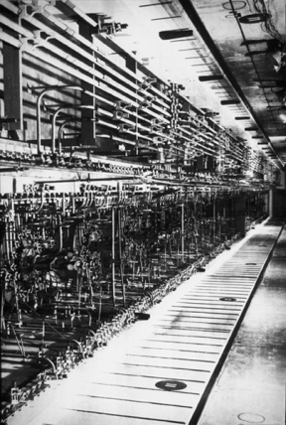
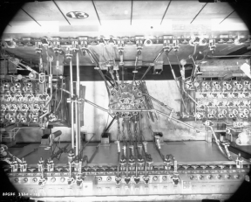
Konsep Seifgard (Safeguard)
Reprocessing plant piping
Sources: DOE
Sumber : How IAEA Safeguards Work, Matthew Bunn IGA-232, Controlling the World’s Most Dangerous Weapons, 20 September 2013, belfercenter.org/mta
Sistem Pengawasan Nuklir (RN6086) Semester 1, TA 2022/2023, Program Studi Magister Ilmu dan Rekayasa Nuklir, FMIPA ITB

Slide 14
Example: some failures in Iran
Konsep Seifgard (Safeguard)
18-year centrifuge program undeclared, undetected by traditional safeguards
Iran imported 100s of kgs of U from China without reporting it – no detection for > a decade
Iran converted 100s of kgs of U to metal – no reporting, no detection, for years
Iran conducted centrifuge tests with UF6, lied to the IAEA in saying it had not done so, was detected years later
Traditional safeguards only designed to monitor declared activities – little capability to address secret activities
However, once other sources informed IAEA of what was happening, IAEA has done a very professional job at peeling back successive layers of Iranian lies
Sumber : Capacity Building For Safeguards : Some Perspectives, MANAGING THE DEVELOPMENT OF NATIONAL INFRASTRUCTURE FOR NUCLEAR POWER Vienna 9 - 12 February 2010
Sistem Pengawasan Nuklir (RN6086) Semester 1, TA 2022/2023, Program Studi Magister Ilmu dan Rekayasa Nuklir, FMIPA ITB

Slide 15
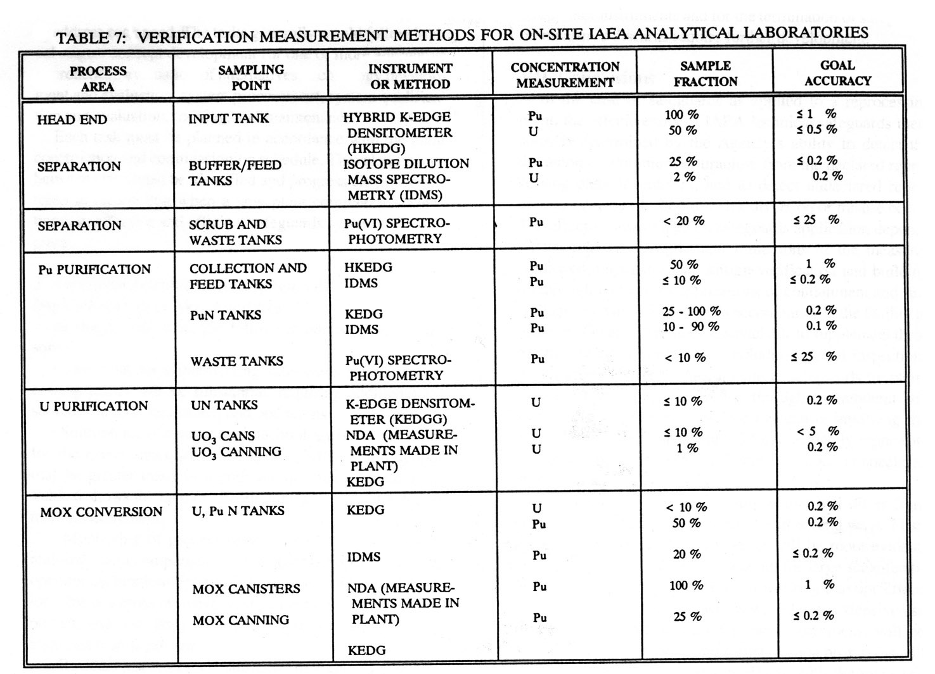
Safeguards technologies: A wide range
Konsep Seifgard (Safeguard)
Source: Shea et al., “Safeguarding Reprocessing Plants,” JNMM, 1993
Sumber : Capacity Building For Safeguards : Some Perspectives, MANAGING THE DEVELOPMENT OF NATIONAL INFRASTRUCTURE FOR NUCLEAR POWER Vienna 9 - 12 February 2010
Sistem Pengawasan Nuklir (RN6086) Semester 1, TA 2022/2023, Program Studi Magister Ilmu dan Rekayasa Nuklir, FMIPA ITB

Slide 16
Konsep Seifgard (Safeguard)
Different steps, different safeguards
Sumber : Capacity Building For Safeguards : Some Perspectives, MANAGING THE DEVELOPMENT OF NATIONAL INFRASTRUCTURE FOR NUCLEAR POWER Vienna 9 - 12 February 2010
Sistem Pengawasan Nuklir (RN6086) Semester 1, TA 2022/2023, Program Studi Magister Ilmu dan Rekayasa Nuklir, FMIPA ITB

Slide 17
Konsep Keamanan (Security)
The Threat Is Real
• Terrorists have stated their desire to use nuclear weapons.
• Acquiring weapons‐useable nuclear material is the key step in constructing a nuclear weapon.
• Weapons‐usable nuclear material exists at hundreds of sites in 25 countries.
• Not all sites are well secured against terrorists or criminals and nuclear security is only as strong as the weakest link.
• Once a terrorist has acquired weapons‐useable nuclear materials, countermeasures have limited effectiveness
Sumber : Introduction to Nuclear Security https://www.nti.org
Sistem Pengawasan Nuklir (RN6086) Semester 1, TA 2022/2023, Program Studi Magister Ilmu dan Rekayasa Nuklir, FMIPA ITB

Slide 18
Konsep Keamanan (Security)
Security Lapses Continue
• Overthelast20years,therehavebeen1000sof nuclear smuggling incidents, of which ~ 20 involved highly enriched uranium or plutonium.
• It’slikelythatmanymorecaseswereundetected.
• Therehavebeennumerouslapsesinsecurity that, under different circumstances, could have been catastrophic:
– Y‐12 (U.S.) security breach (2012)
– Pelindaba (South Africa) break‐in (2007)
– Kurchatov Institute (Russia) accounting problem (2001)
Global Nuclear Security System
• Nuclear security is historically viewed as the sovereign responsibility of individual states.
• Each country’s regulatory systems were often developed independently.
– Often variable
• There is no comprehensive global system for tracking, protecting, and managing nuclear materials in a way that builds confidence.
– The existing international system is a patchwork of agreements, guidelines, and multilateral engagement mechanisms.
– It encompasses only civilian materials (15% of total weapons‐ useable nuclear materials).
Sumber : Introduction to Nuclear Security https://www.nti.org
Sistem Pengawasan Nuklir (RN6086) Semester 1, TA 2022/2023, Program Studi Magister Ilmu dan Rekayasa Nuklir, FMIPA ITB

Slide 19
Konsep Keamanan (Security)
Sumber : Introduction to Nuclear Security https://www.nti.org
Sistem Pengawasan Nuklir (RN6086) Semester 1, TA 2022/2023, Program Studi Magister Ilmu dan Rekayasa Nuklir, FMIPA ITB

Slide 20
Konsep Keamanan (Security)
IAEA’s Security Role • The principle objective is to“accelerate and enlarge the contribution of atomic energy...” • It administers a safeguards system to detect diversion for military purposes.
• Nuclear security is a relatively new mission.
• IAEA develops nuclear security guidelines and provides numerous nuclear security advisory services.
• The scope of responsibility is civilian materials, largely outside the five nuclear weapons states
Summary and Discussion
• Nuclear security is a cornerstone of preventing nuclear terrorism.
• An attack anywhere would be an attack everywhere.
• Currently, nuclear materials security largely depends on actions by individual states.
• A comprehensive global system is needed to provide confidence in each state’s materials security.
Sumber : Introduction to Nuclear Security https://www.nti.org
Sistem Pengawasan Nuklir (RN6086) Semester 1, TA 2022/2023, Program Studi Magister Ilmu dan Rekayasa Nuklir, FMIPA ITB

Slide 21
Konsep Keamanan (Security)
NTI Nuclear Materials Security Index (NTI Index)
Sumber : Introduction to Nuclear Security, Nuclear Threat Initiative, www.nti.org
Sistem Pengawasan Nuklir (RN6086) Semester 1, TA 2022/2023, Program Studi Magister Ilmu dan Rekayasa Nuklir, FMIPA ITB

Slide 22
Konsep Keamanan (Security)
NTI Nuclear Materials Security Index (NTI Index)
Sumber : Alberto Muti , Nuclear Safety, Security and Safeguards, VERTIC
Sistem Pengawasan Nuklir (RN6086) Semester 1, TA 2022/2023, Program Studi Magister Ilmu dan Rekayasa Nuklir, FMIPA ITB

Slide 23
Konsep Keamanan (Security)
NTI Nuclear Materials Security Index (NTI Index)
Sumber : Introduction to Nuclear Security, Nuclear Threat Initiative, www.nti.org
Sistem Pengawasan Nuklir (RN6086) Semester 1, TA 2022/2023, Program Studi Magister Ilmu dan Rekayasa Nuklir, FMIPA ITB

Slide 24
Konsep Keamanan (Security)
NTI Nuclear Materials Security Index (NTI Index)
Sumber : Introduction to Nuclear Security, Nuclear Threat Initiative, www.nti.org
Sistem Pengawasan Nuklir (RN6086) Semester 1, TA 2022/2023, Program Studi Magister Ilmu dan Rekayasa Nuklir, FMIPA ITB

Slide 25
Konsep Keamanan (Security)
NTI Nuclear Materials Security Index (NTI Index)
Key Index Findings • Governments are more aware of the threat and are engaged.
• The consensus on priorities is lacking.
• The lack of openness impedes confidence and accountability.
Several states are more vulnerable to insider threats.
Stocks of weapons‐usable nuclear materials continue to increase. • More states could eliminate their stocks. • Many states lag on joining international agreements
Sumber : Introduction to Nuclear Security, Nuclear Threat Initiative, www.nti.org
Sistem Pengawasan Nuklir (RN6086) Semester 1, TA 2022/2023, Program Studi Magister Ilmu dan Rekayasa Nuklir, FMIPA ITB

Slide 26
Konsep Keamanan (Security)
Recommendations
– Reach consensus on the key principles of a global system
Cover all weapons‐usable materials, military and civilian
Apply international standards and best practices
Build confidence and accountability
– Become parties to nuclear security treaties
– Strengthen voluntary mechanisms
– Secure military and other non‐civilian materials to same or higher standards as civilian materials
• Each country:
– Decrease stocks of weapons‐usable nuclear materials
– Improve measures to protect weapons‐usable nuclear materials from theft
– Establish and strengthen independent regulatory agencies
– Deliver on Nuclear Security Summit commitments
Sumber : Introduction to Nuclear Security, Nuclear Threat Initiative, www.nti.org
Sistem Pengawasan Nuklir (RN6086) Semester 1, TA 2022/2023, Program Studi Magister Ilmu dan Rekayasa Nuklir, FMIPA ITB

Slide 27



Konsep Keamanan (Security)
Convention for the Physical Protection of Nuclear Material (CPPNM)
Binding treaty requiring states to apply physical protection measures to nuclear material, primarily during international transportation.
2005 Amendment expanded the CPPNM’s scope to require protection of nuclear materials in use, storage, and domestic transit, and protection of nuclear facilities from sabotage
IAEA Fundamental Principles
A set of principles adopted by the IAEA Board of Governors and meant as a step toward strengthening the physical security regime and promoting the effective implementation and improvement of physical protection worldwide. They have been incorporated into the 2005 Amendment to the CPPNM
Safeguards and Nuclear Material Accounting
IAEA safeguards agreements require states to apply
standard nuclear material accounting systems. All states with nuclear material (except NK) have safeguards agreements in place, though coverage depends on whether a state is a NWS, a NNWS, or non‐NPT state
Sumber : Introduction to Nuclear Security, Nuclear Threat Initiative, www.nti.org
Sistem Pengawasan Nuklir (RN6086) Semester 1, TA 2022/2023, Program Studi Magister Ilmu dan Rekayasa Nuklir, FMIPA ITB

Slide 28




Konsep Keamanan (Security)
Nuclear Suppliers Group (NSG)
The NSG was established to ensure that suppliers apply a uniform approach to nuclear and nuclear‐related exports and dual‐use items. NSG guidelines aim to ensure that peaceful nuclear trade does not contribute to proliferation of nuclear weapons. Suppliers should authorize transfers of trigger list items only where those items will be subject to safeguards. Guidelines also state that recipients should have physical security measures in place
Nuclear Security Summits
Brings together government leaders from states around
the world to focus high‐level attention on the threat of nuclear terrorism. The summit produces a communiqué identifying priority areas. At the close of the 2010 Summit, more than 60 national commitments were made, over 80% of which were achieved by the 2012 Summit. At the 2012 Summit, over 100 commitments were made. The next summit will be held in 2014
G8 Global Partnership
A 2002 G8 initiative committed to preventing terrorists from acquiring or developing WMD. G8 countries pledged $20 billion over the first 10 years to fund projects to secure and dismantle WMD stockpiles in Russia. Since then the Global Partnership has successfully implemented numerous projects, including outside Russia. The G8 extended the GP for another ten years. Its informal nature allows countries to match resources to specific projects
Sumber : Introduction to Nuclear Security, Nuclear Threat Initiative, www.nti.org
Sistem Pengawasan Nuklir (RN6086) Semester 1, TA 2022/2023, Program Studi Magister Ilmu dan Rekayasa Nuklir, FMIPA ITB

Slide 29
Konsep Keamanan (Security)
Global Initiative to Combat Nuclear Terrorism (GICNT)
The GICNT provides another informal mechanism for state cooperation. Its mission is to strengthen global capacity to prevent, detect, and respond to nuclear terrorism. Partner nations conduct multilateral activities, workshops, table‐top exercises, and field exercises
Proliferation Security Initiative (PSI)
An informal grouping of states that have joined together to
prevent trafficking by detecting and intercepting WMD and WMD‐related materials. Countries commit to strengthen national legal authorities to facilitate interdiction, develop procedures to facilitate exchange of information, and take specific actions in support of interdiction efforts. Shipboarding agreements give parties permission to board vessels sailing under the other parties’ national flag. Several high‐profile successes in interdicting or turning back WMD‐related shipments have been attributed to PSI.
Sumber : Introduction to Nuclear Security, Nuclear Threat Initiative, www.nti.org
Sistem Pengawasan Nuklir (RN6086) Semester 1, TA 2022/2023, Program Studi Magister Ilmu dan Rekayasa Nuklir, FMIPA ITB

Slide 30
Konsep Keamanan (Security)
IAEA Nuclear Security Advisory Services
Although the IAEA’s mandate is limited to safeguards,
recognizing that it has the technical knowledge and experience to provide advice and assistance in the security area, the IAEA provides advisory services. These services include missions, evaluations, and technical services to help requesting states assess their nuclear security needs and improve their capabilities for securing nuclear material
World Institute for Nuclear Security (WINS)
An organization whose purpose is to provide a forum for nuclear security professionals to share and promote best security practices. Best practice exchanges can be a valuable tool to enable rapid and dynamic improvements for facilities’ security implementation. WINS produces best practices guides, including self‐assessment tools, and is developing accreditation and training for nuclear security professionals. WINS is also developing peer review offerings.
Sumber : Introduction to Nuclear Security, Nuclear Threat Initiative, www.nti.org
Sistem Pengawasan Nuklir (RN6086) Semester 1, TA 2022/2023, Program Studi Magister Ilmu dan Rekayasa Nuklir, FMIPA ITB

Slide 31
Konsep Keamanan (Security)
Existing Nuclear Security System
Sumber : Introduction to Nuclear Security, Nuclear Threat Initiative, www.nti.org
Sistem Pengawasan Nuklir (RN6086) Semester 1, TA 2022/2023, Program Studi Magister Ilmu dan Rekayasa Nuklir, FMIPA ITB

Slide 32


Semester 1 2022/2023
Sistem Pengawasan Nuklir (RN6086)
FMIPA ITB
²³²Thank YoU²³⁸
TeriMA Kasih
Merci
Sidik Permana Nuclear Physics and Biophysics Research Division
Physics Department, Nuclear Science and Engineering Department, Faculty of Matematis and Natural Sciences, Institut Teknologi Bandung
Sistem Pengawasan Nuklir (RN6086) Semester 1, TA 2022/2023, Program Studi Magister Ilmu dan Rekayasa Nuklir, FMIPA ITB

